Slide 1
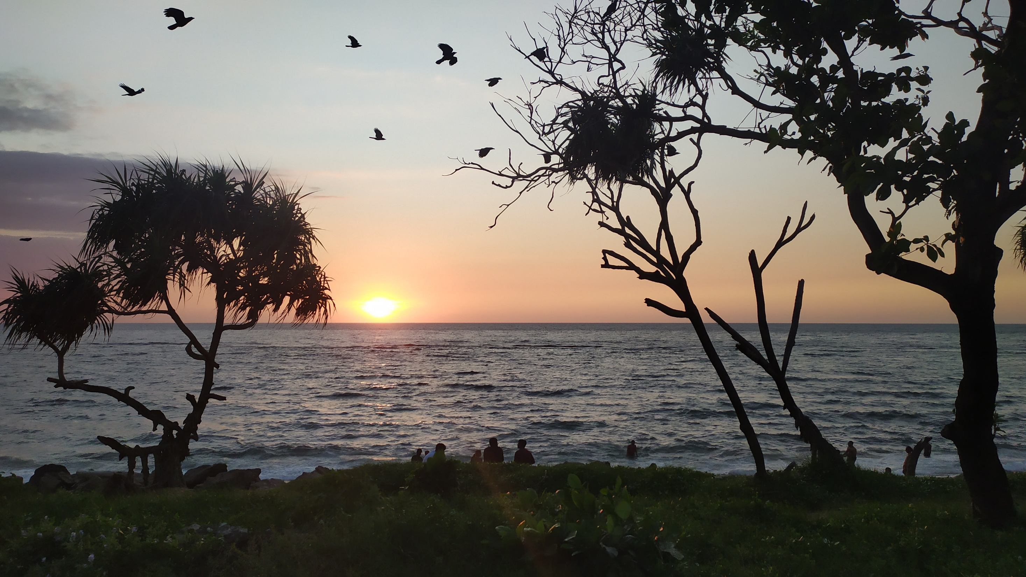

Slide 2

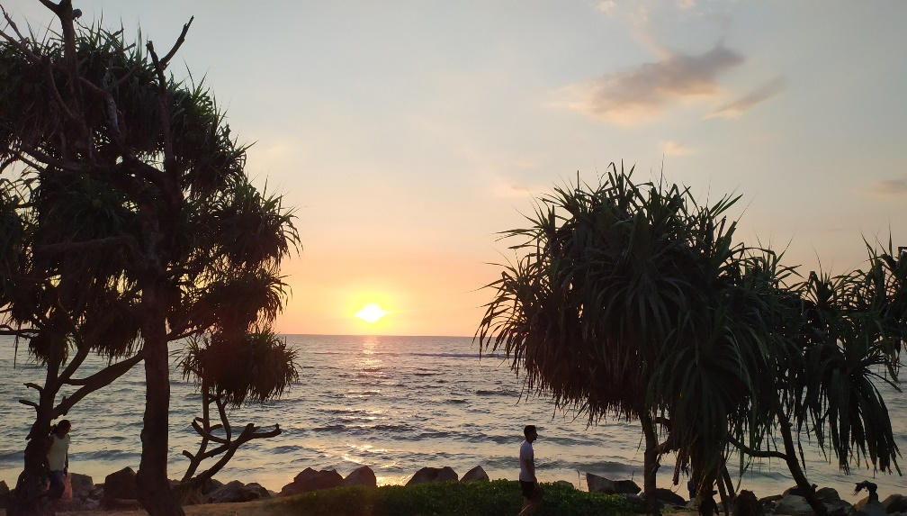
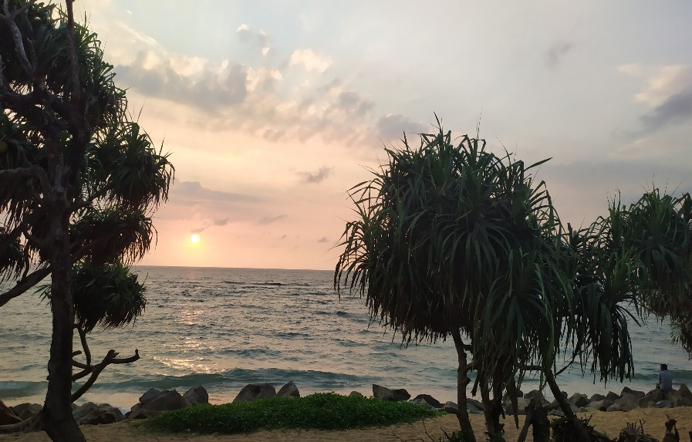
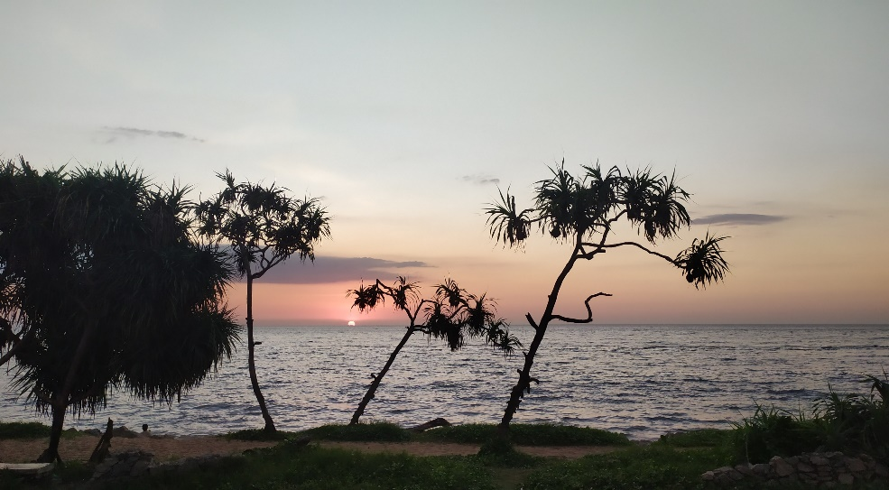
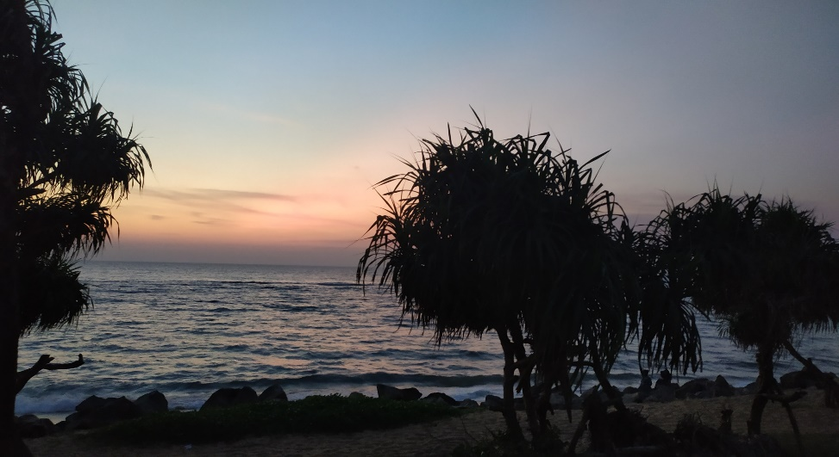
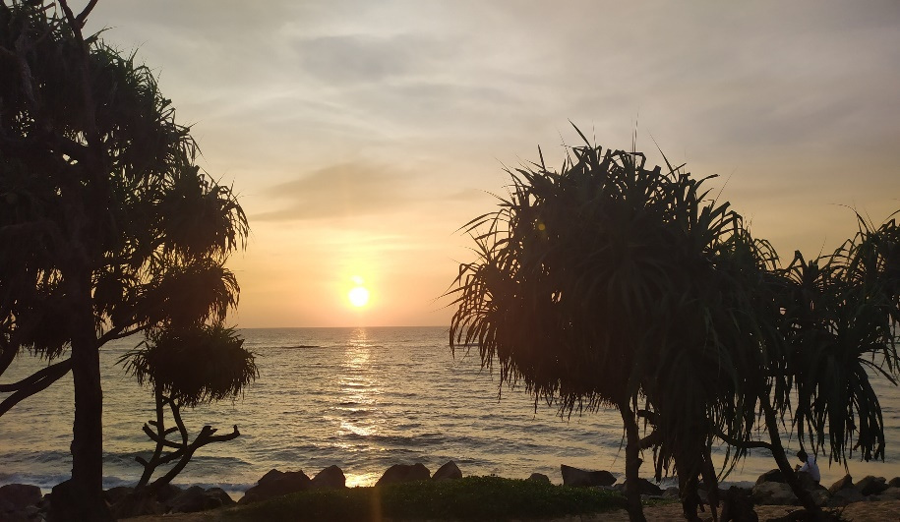
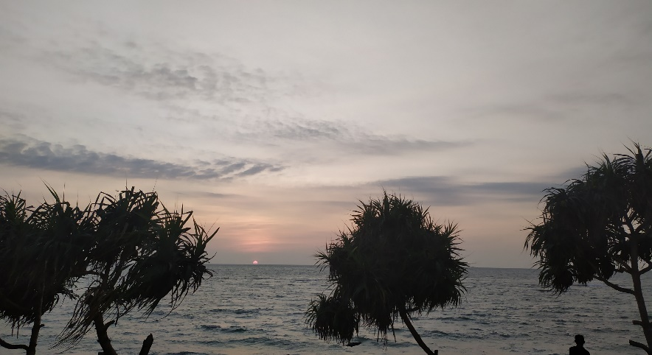
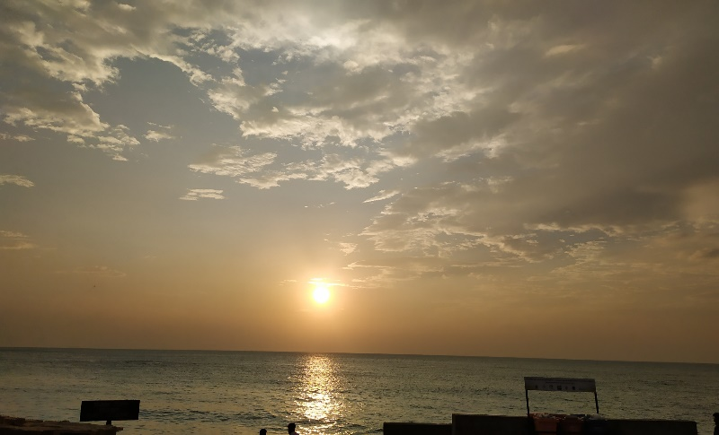
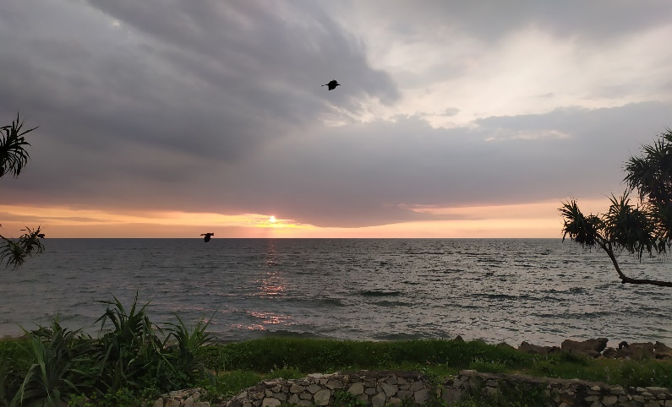

Slide 3

Every Day Is Another Chance To Change Your Life

Slide 4
Are you satisfied with your life now?
Notes:
There are so many people who are blind, deaf and with so many other diseases.
We see lots of people who are really poor and with children.

Slide 5
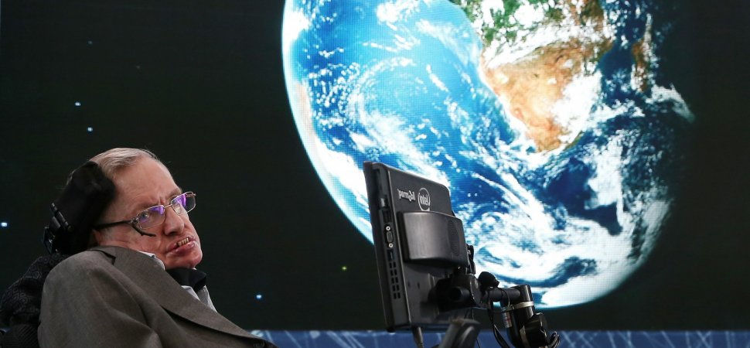
Stephen Hawking
Notes:
the world-famous theoretical physics born in 1942
the world-famous theoretical physicis
The disease reduced his bodily control to the flexing of a finger and voluntary eye movements but left his mental faculties untouched
After the loss of his speech, he was able to communicate through a speech-generating device – initially through use of a handheld switch, and eventually by using a single cheek muscle. He died on 14 March 2018 at the age of 76, after living with the disease for more than 50 years.

Slide 6
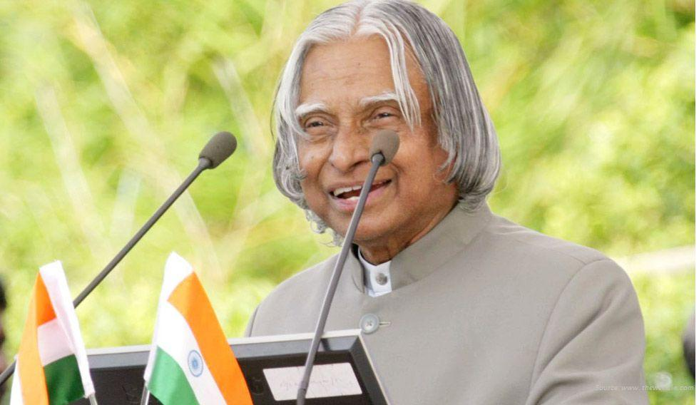
ABDUL KALAM
Notes:
His father Jainulabdeen was a boat owner and imam of a local mosque;^{[9]} his mother Ashiamma was a housewife.
he sold newspapers to supplement his family's income.

Slide 7
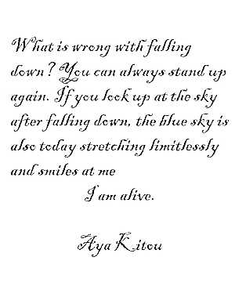
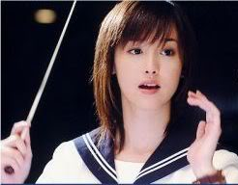
Aya kito (1 litre of tears)
Notes:
based on a true story of a 15-year-old girl named Aya Kitō, who suffered from degenerative disease and died at the age of 25.
Aya's diary that she kept writing until she could no longer hold a pen

Slide 8
